Slide 1
Customer Churn Data Analysis Report
Data Gathering, Exploratory Data Analysis, and Data Preparation

Slide 2
Introduction
Customer churn is a critical challenge for financial institutions because acquiring new customers is significantly more expensive than retaining existing ones. Predicting churn enables organizations to proactively identify customers who may discontinue services and implement targeted retention strategies.
In this project, data analysis techniques were used to explore customer data and prepare it for building a predictive churn model. The objective of this task was to gather relevant datasets, perform exploratory data analysis (EDA), and clean and preprocess the data to ensure it is suitable for machine learning.

Slide 3
Data Gathering and Data Sources
To understand the factors influencing customer churn, multiple datasets were collected from different sources within the banking system. These datasets provide insights into customer demographics, financial behavior, digital engagement, and service interactions.

Slide 4
Customer Demographics
This dataset contains personal information about customers, including age, gender, marital status, and income level. Demographic attributes often influence customer financial behavior and engagement patterns.
Transaction History
This dataset records customer spending behavior and transaction activity. Transaction data helps identify patterns in financial usage that may indicate disengagement or reduced banking activity.
Customer Service Interactions
This dataset includes records of customer service requests and interactions. Frequent complaints or support requests may indicate dissatisfaction, which can increase the likelihood of churn.

Slide 5
Online Activity
This dataset captures digital engagement metrics such as login frequency and usage of online banking platforms. Customers who interact less frequently with digital services may be more likely to discontinue their relationship with the bank.
Churn Status
This dataset contains the churn label, indicating whether a customer has left the bank's services. It serves as the target variable for predictive modeling. All datasets were integrated using the CustomerID field to create a unified dataset containing one record per customer.

Slide 6
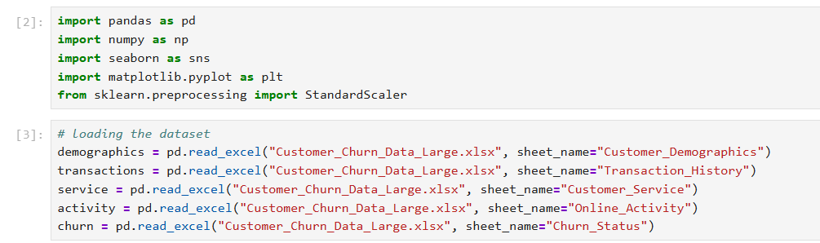

Slide 7
Data Integration
Since customer data was stored across multiple tables, the datasets were merged using the CustomerID key. This ensured that all relevant customer information was consolidated into a single dataset.
Transaction records were aggregated to compute total spending per customer, enabling a clear understanding of each customer's financial activity.
After merging the datasets, a unified dataset was created containing demographic attributes, transaction behavior, digital engagement metrics, and churn status.
This integrated dataset forms the foundation for exploratory analysis and predictive modeling.

Slide 8
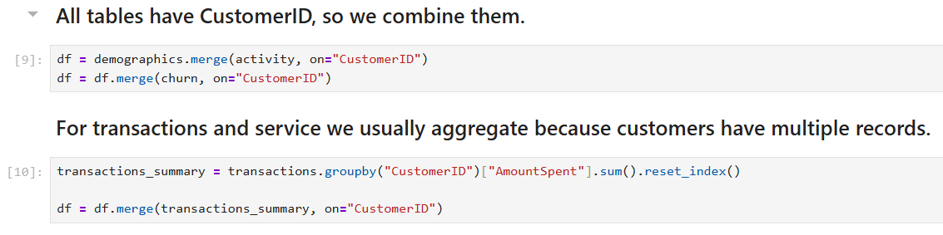

Slide 9
Exploratory Data Analysis (EDA)
Exploratory Data Analysis was performed to understand the structure of the dataset, identify trends, detect anomalies, and discover potential relationships between variables and customer churn.
EDA involved both statistical analysis and data visualization.

Slide 10
Age Distribution
A histogram was used to analyze the distribution of customer ages. The analysis shows that the customer base consists mainly of young to middle-aged individuals. Understanding the age distribution helps determine whether churn behavior varies across different age groups.
Transaction Spending Analysis
A boxplot was used to examine the distribution of Amount Spent by customers. The visualization showed that most transaction values fall within a reasonable range. No significant outliers were observed outside the whiskers of the boxplot, indicating that transaction spending values are relatively stable and do not require outlier removal.
Login Frequency and Customer Churn
A boxplot was used to compare login frequency between customers who churned and those who remained active. The analysis indicates that customers with lower login frequency tend to have a higher probability of churn. This suggests that reduced digital engagement may be an early indicator of customer disengagement.

Slide 11
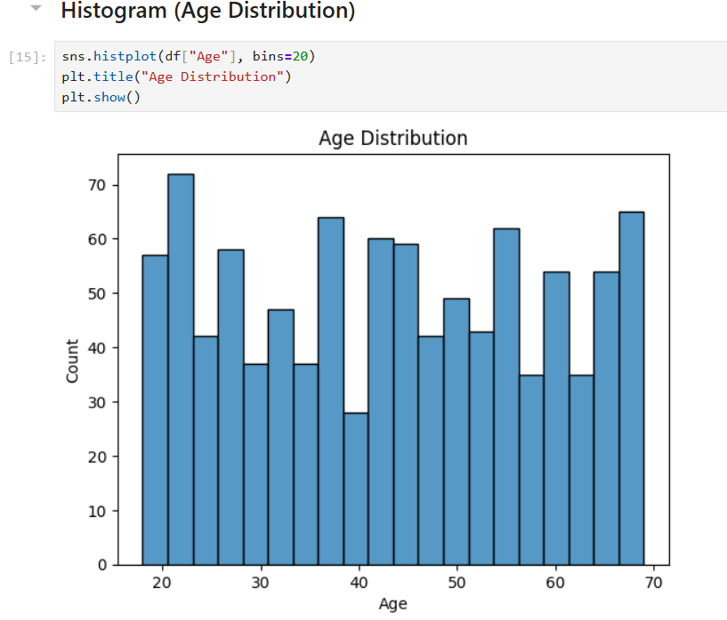

Slide 12
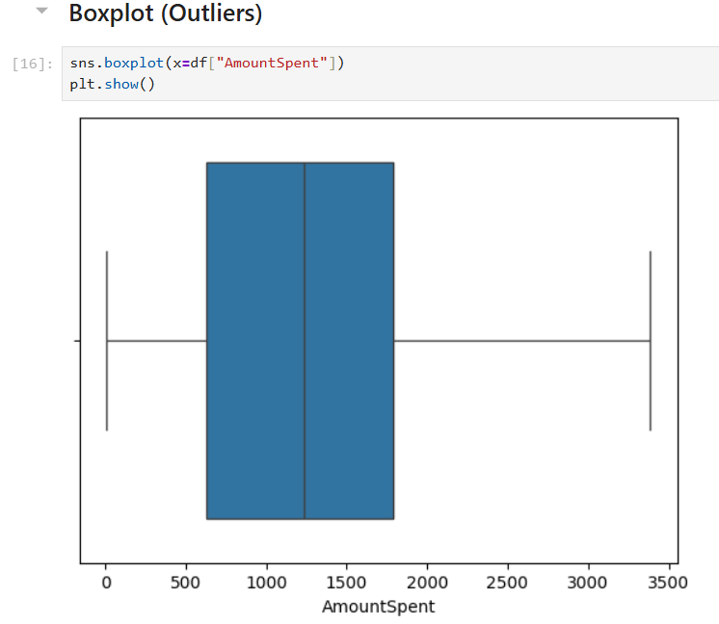

Slide 13
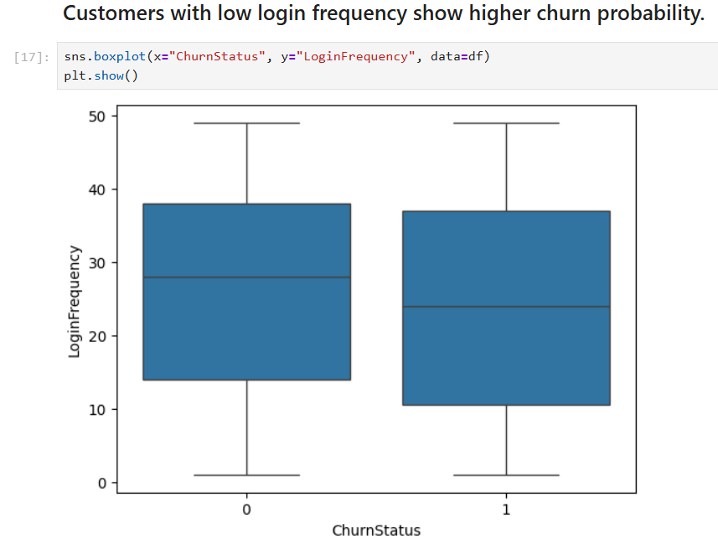

Slide 14
Gender Distribution
A count plot was used to analyze the distribution of customers by gender. The visualization helps determine whether the dataset is balanced between male and female customers. Understanding gender distribution is important because demographic factors may influence financial behavior and engagement patterns.
Income Level Distribution
A count plot was used to examine the distribution of customers across different income levels. Income segmentation helps identify whether customers with lower income levels exhibit higher churn tendencies due to pricing sensitivity or financial constraints.
Correlation Analysis
A correlation heatmap was generated to examine relationships between numerical variables. This analysis helps identify variables that may be strongly associated with customer churn, such as login frequency, transaction spending, or service usage. Understanding these relationships provides valuable insights for selecting features when building predictive models.

Slide 15
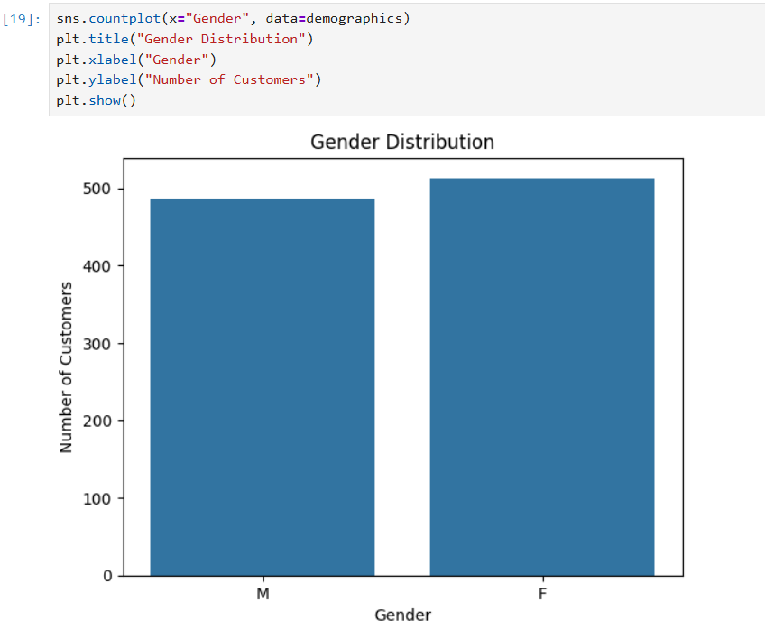

Slide 16
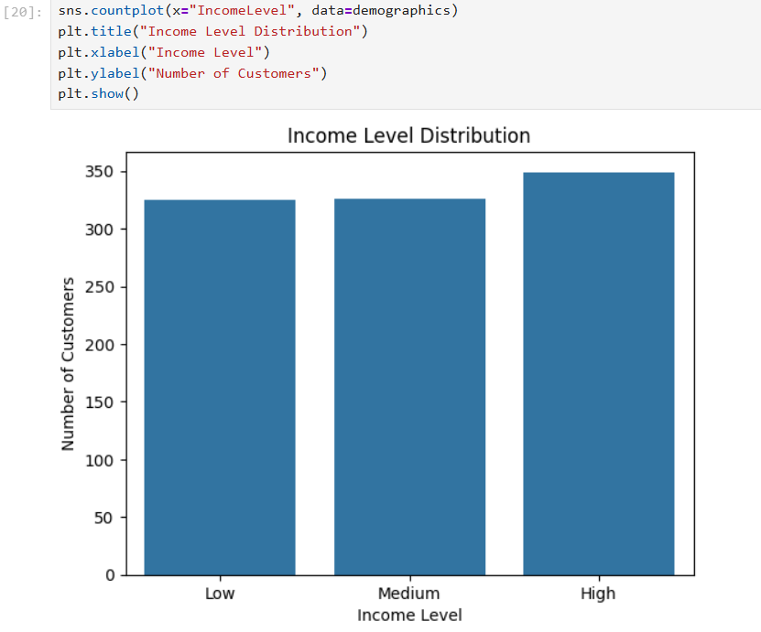

Slide 17
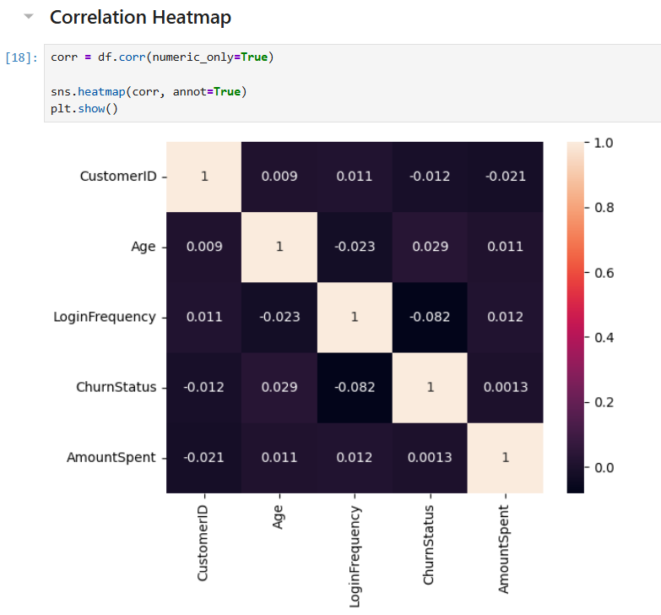

Slide 18
Data Cleaning and Preprocessing
Before building machine learning models, the dataset was cleaned and preprocessed to ensure data quality and consistency.
Handling Missing Values
The dataset was examined for missing values using data profiling techniques. The analysis showed that there were no significant missing values in the dataset. Therefore, no imputation or removal of records was required.

Slide 19
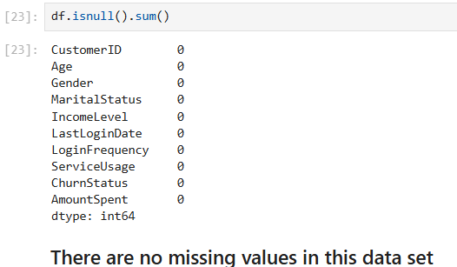

Slide 20

Outlier Detection
Outliers were analyzed using boxplots, particularly for the AmountSpent variable. The analysis indicated that transaction values were within acceptable ranges and no extreme outliers were detected. As a result, no outlier treatment was necessary.
Encoding Categorical Variables
Machine learning algorithms require numerical input, so categorical variables such as:
Gender
Marital Status
Income Level
Service Usage were transformed using One-Hot Encoding.
This method converts each category into a binary variable while preventing the model from assuming an ordinal relationship between categories.

Slide 21
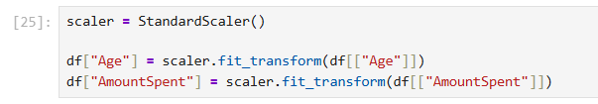
Feature Scaling
To ensure that numerical features contribute equally to machine learning algorithms, feature scaling was applied.
Numerical variables such as:
Age
Transaction Amount were standardized using Standardization (Z-score scaling) so that they have a mean of zero and a standard deviation of one.
This step improves model performance and prevents features with larger scales from dominating the learning process.

Slide 22
Final Prepared Dataset
After completing the preprocessing steps, the final dataset contains:
Cleaned and standardized numerical variables
Encoded categorical variables
Aggregated transaction data
Customer churn status
Each row in the dataset represents a single customer, making it suitable for training machine learning models.
The prepared dataset is now ready to be used for predictive modeling to identify customers who are at risk of churning.

Slide 23
Conclusion
This task involved gathering and preparing data for customer churn prediction. Multiple datasets were integrated to capture different aspects of customer behavior, including demographics, financial activity, digital engagement, and customer service interactions.
Exploratory data analysis revealed important patterns, such as the relationship between login frequency and customer churn. Data cleaning and preprocessing steps ensured that the dataset is structured, consistent, and suitable for machine learning algorithms.
The final dataset provides a solid foundation for building predictive models that can help the bank identify customers at risk of churn and implement targeted retention strategies.

